Slide 1

Use Slide Layout “Overall Title and Content”
Introduce the real-world problem your team aims to solve, highlighting affected parties due to this problem, and the Importance of solving this problem.
Utilize figures, descriptions, and facts to provide a comprehensive overview of your problem.
Prepare a video that is no longer than 2 minutes to explain this information.
The following information should be covered in this section
Introduction to the problem
Social or research impact of the solution
Previous research and its shortcomings, your approach to address them
Constraints and Limitations
Overall System Diagram
Then you can proceed to the individual student explanation
8/26/2025
1

Slide 2
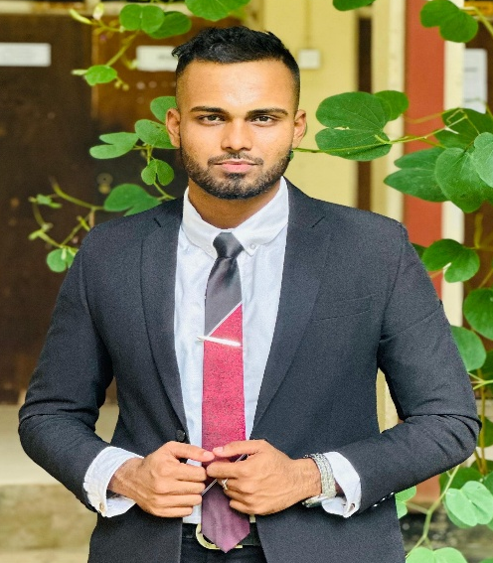
Enhance Color Coordination in Dyslexic Learners
Student Must add a professional photo to this cage
Specialization: Specialized in IT
Vithanage B H |
25-26J-296
2

Slide 3

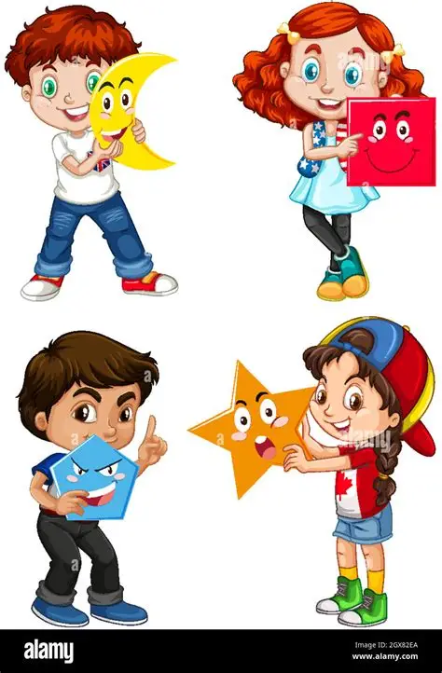
Enhance Colour Coordination in Dyslexic
Learners
Background
Dyslexia affection on visual processing
Color differentiation and coordination
Indirectly boost reading, memory, and confidence
Problem Statement
Existing Tools
Gap
Vithanage B H |
25-26J-296

Slide 4



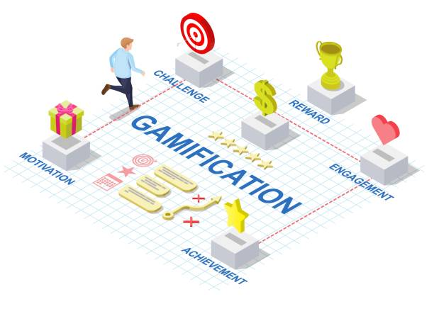

Enhance Colour Coordination in Dyslexic
Learners
Key Domains of Specialization
Artificial Intelligence & Machine Learning
Human-Computer Interaction (HCI)
Cognitive & Educational Psychology
Educational Technology
Technology Stack
Flutter
Vithanage B H |
25-26J-296

Slide 5
Enhance Colour Coordination in Dyslexic
Learners
How to Evaluate/Prove Success
Usability Testing → measure engagement and ease of use with dyslexic children.
Performance Metrics → accuracy in color recognition tasks, reduced response time, improved coordination.
Pre/Post Intervention Tests → measure improvement in visual/color tasks compared to baseline.
Expected Outcomes → >70% accuracy improvement in personalized activities within a set training period.
Vithanage B H |
25-26J-296

Slide 6
FOURTH SLIDE: THIS SLIDE MUST INCLUDE THE FOLLOWING SECTIONS ABOUT THE INDIVIDUAL COMPONENT
System Overview
Mobile-based Module within the dyslexia learning app.
Core features:
Interactive games → color-matching, sorting, contrast recognition.
Adaptive difficulty → ML model adjusts challenges based on child’s performance.
Progress tracking → dashboard for parents/teachers.
Technology Stack:
Frontend: Flutter / React Native
Backend: Firebase / Python ML Models
AI: TensorFlow Lite (on-device personalization)
<<Student Name>> |
<<Project ID>>

Slide 7
Last Slide: This slide MUST include the following sections about the ENTIRE Project
Ability of Commercialization (15%)
Investment/cost (Labor + Material) & How to Recover the Investment/cost (Pricing)
Target market, customer profile, Value Proposition, Intellectual Property Rights, etc.
Note: You should put “Overall Project Title” at the top of the Slide
8/26/2025
6

